Slide 1

TEAM MEMBERS
Abdulrahman Sayed
Mohamed Ibrahim
Mohamed Abdul Hamid
Saif Ahmed
Instructor: Osama Adel

Slide 2
DATA ANALYSIS FOR UK-RAILWAY

Slide 4
TABLE OF CONTENTS
01
02
03
Infrastructure
& Preprocessing
04
Visualization Dashboard
Analysis Questions
05
Recommendations
Forecasting Questions

Slide 5
Infrastructure & Preprocessing
01.

Slide 6
Phase 1: Overview
focus:
Building data infrastructure
Designing the data model
Pre-processing data
Key deliverables:
Data Warehouse
Star Schema Design
Data Cleaning Pipeline
Tools:
SQL Server
Python

Slide 7
Data Warehouse Architecture
Three-Layer Data Architecture:
Bronze layer(Source): Unprocessed data ingested directly from the source file.
Silver layer(Staging area): Cleaned, validated, and transformed data from the bronze layer with quality checks.
Gold layer(Business-ready): Dimensional star schema model optimized for analysis.
Implementation Details:
SQL Server database with schema separation for each layer.
Python-based ETL processes for data transformation between layers.
Integration of stored procedures for automated loading.

Slide 8
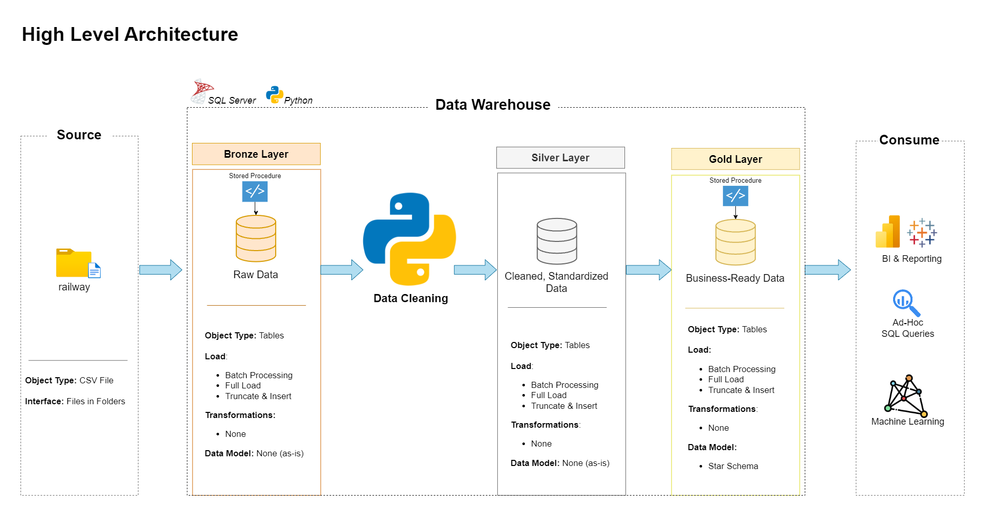
Data Warehouse Architecture

Slide 9
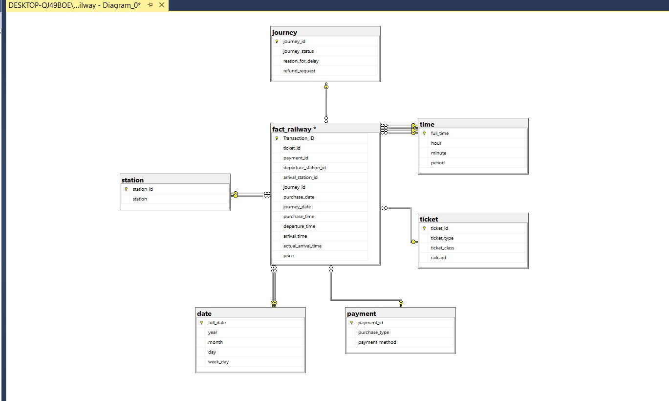

Slide 10
Data Cleaning Process
Standardization Steps:
Column naming convention: Converted to snake case.
Data type conversions: Proper date and time formats for all temporal fields.
Missing value handling: Identified null values in cancelled journeys.
Validation checks for data consistency and integrity.

Slide 11
Analysis Questions
O2.

Slide 12
Phase 2: Overview
focus:
Determine a set of analysis questions
Key deliverables:
A set of analysis questions with the answers
Tools:
SQL Server

Slide 13
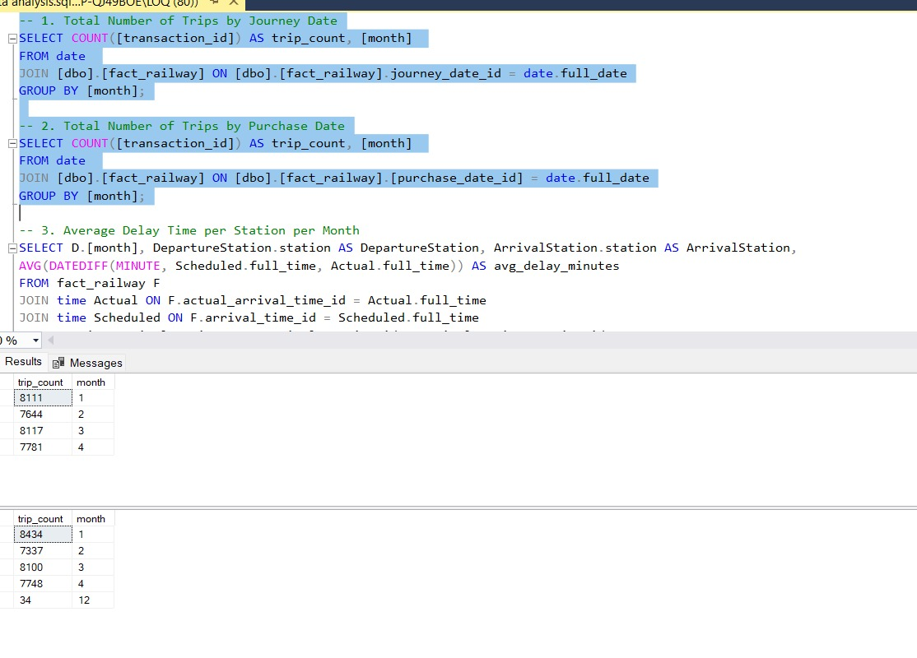

Slide 14
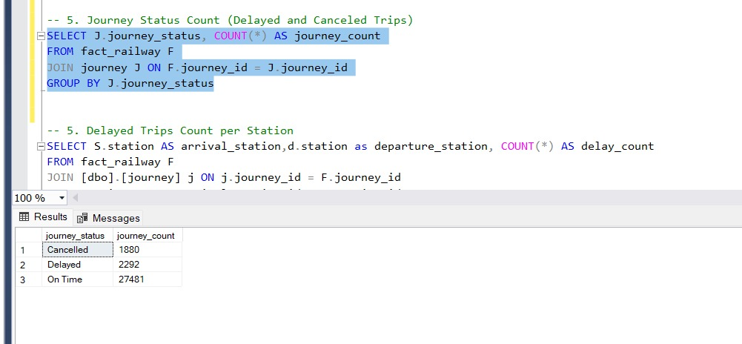

Slide 15
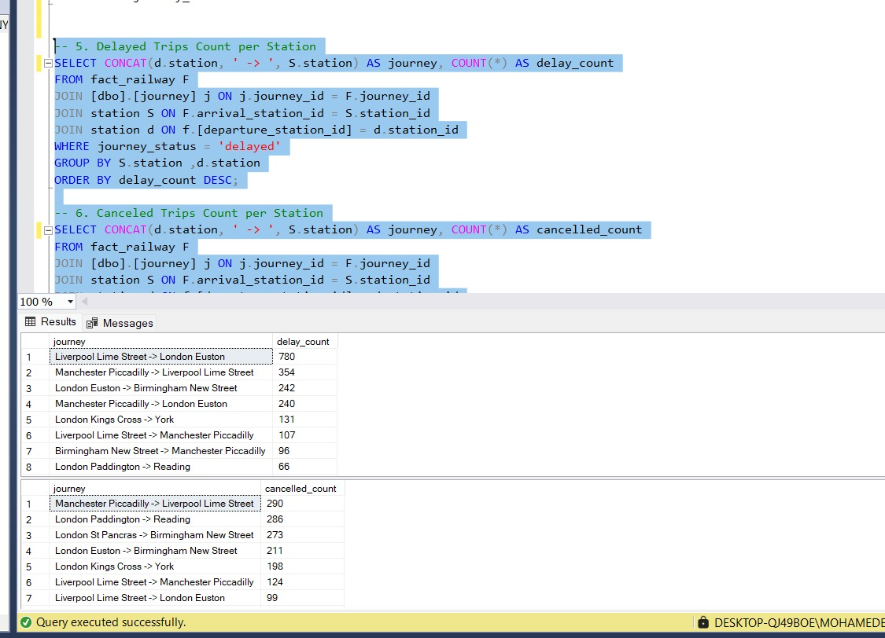

Slide 16
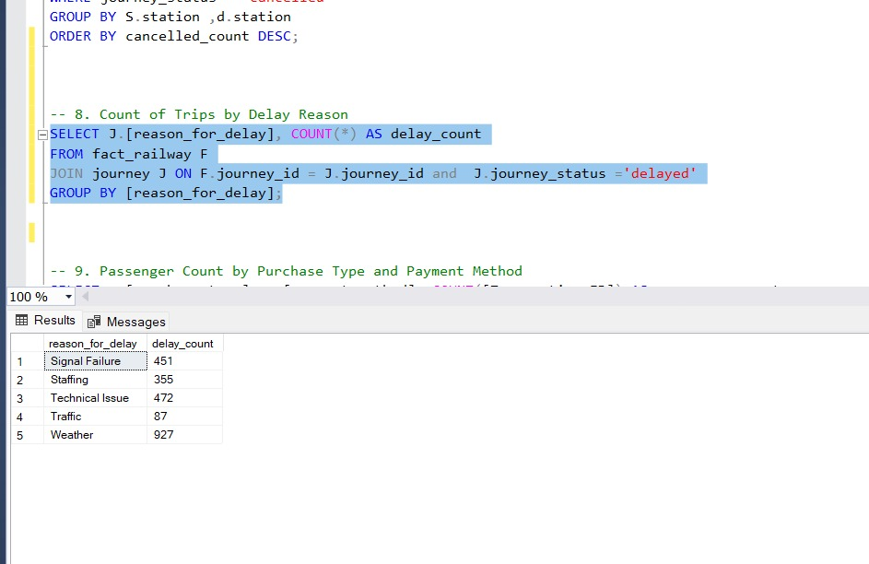

Slide 17
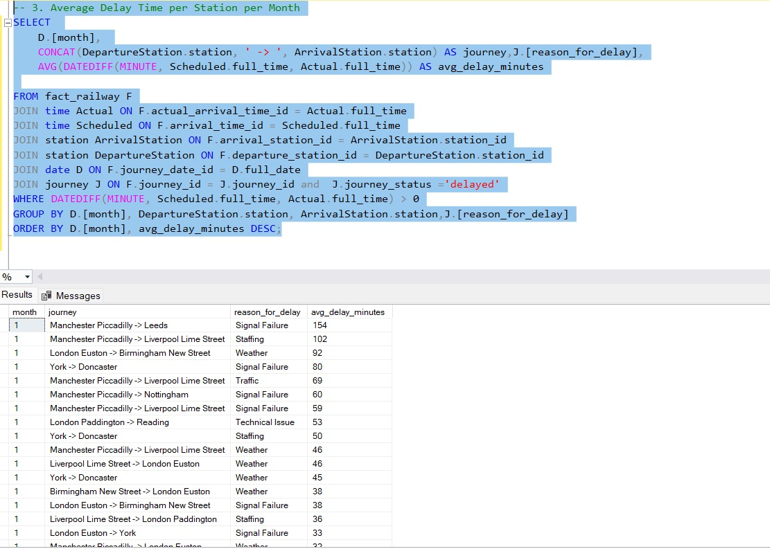

Slide 18
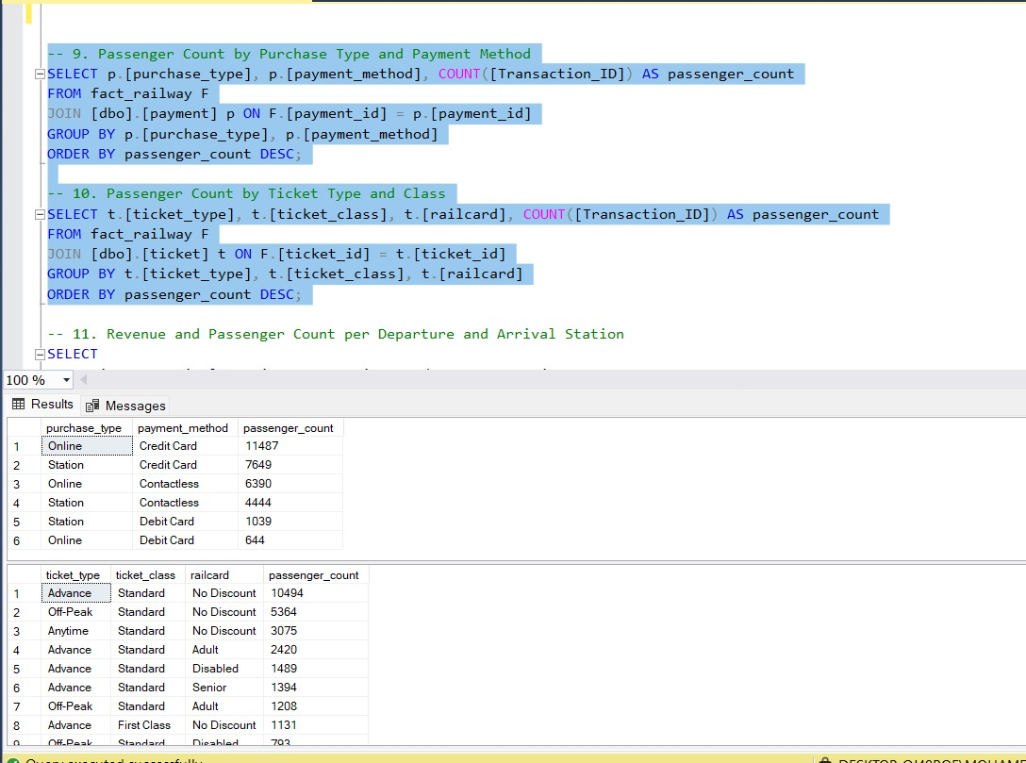

Slide 19
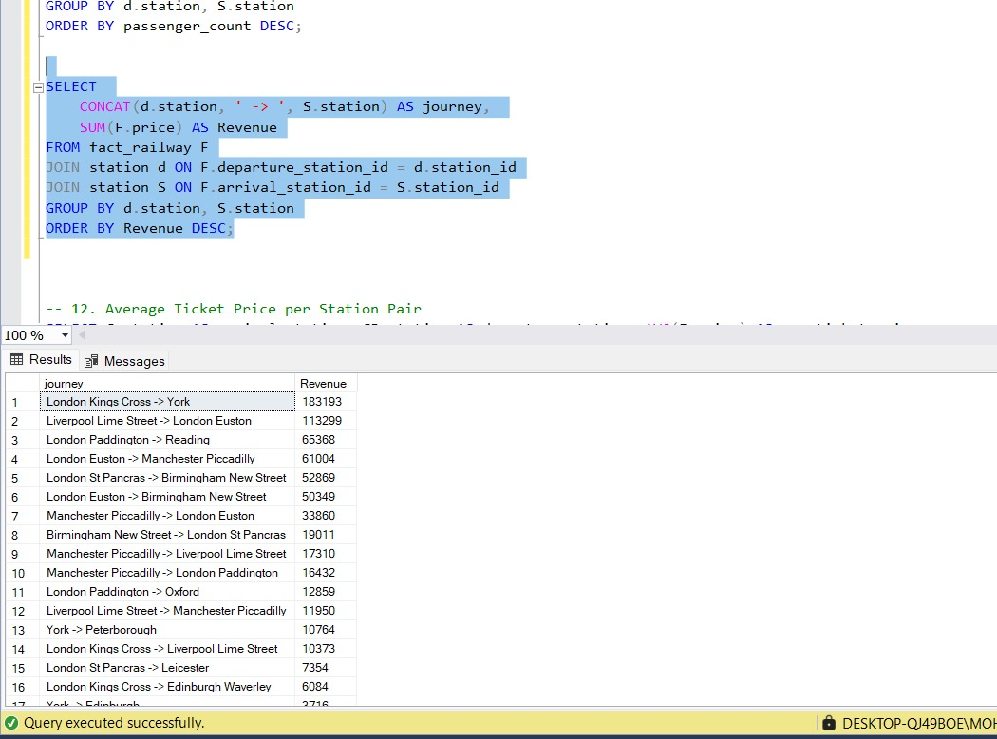

Slide 20
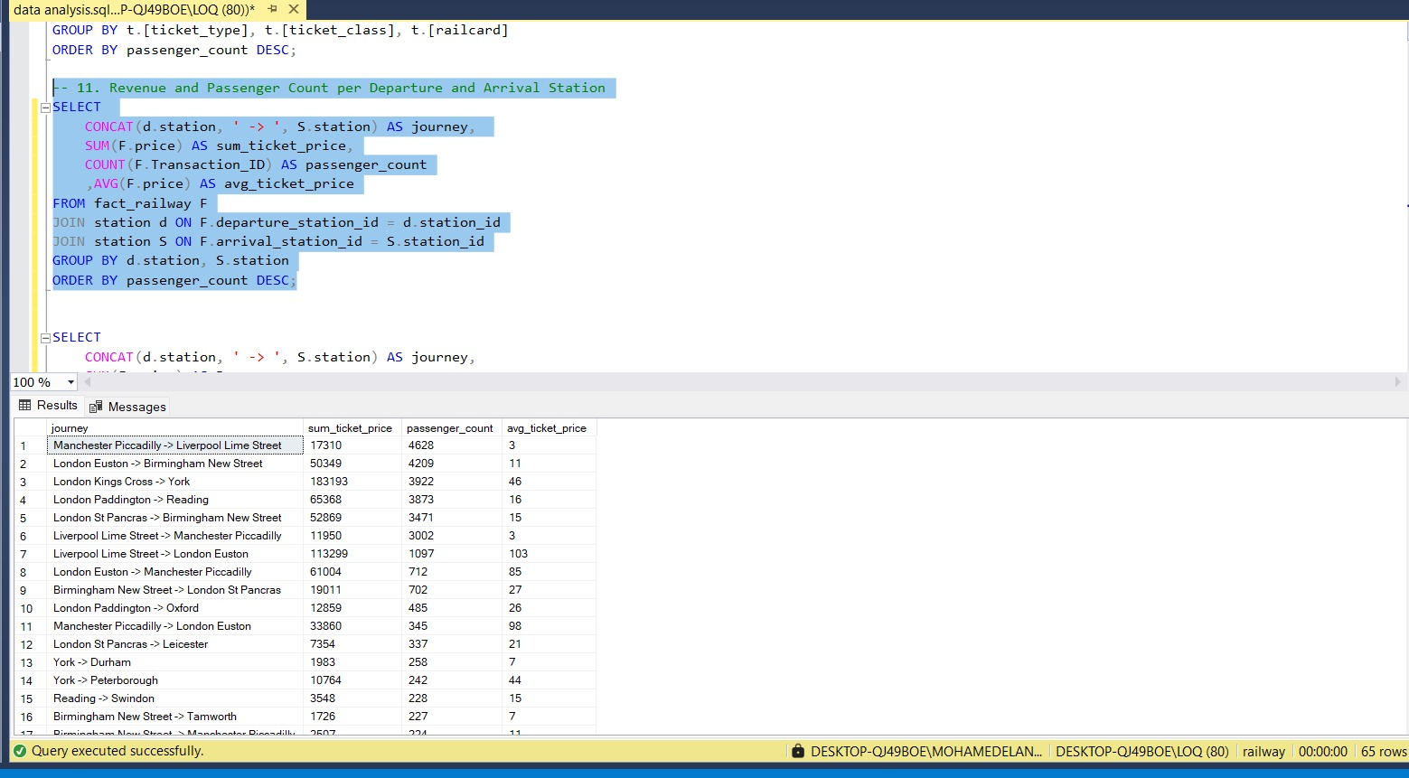

Slide 21
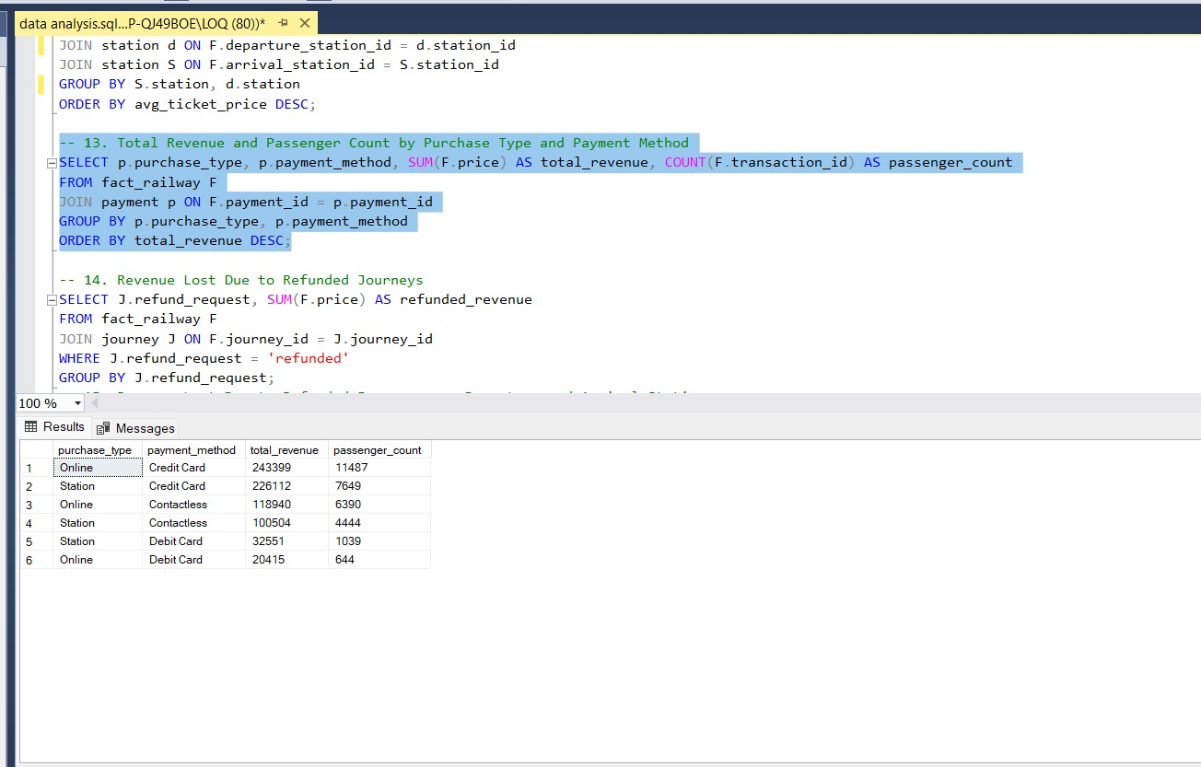

Slide 22
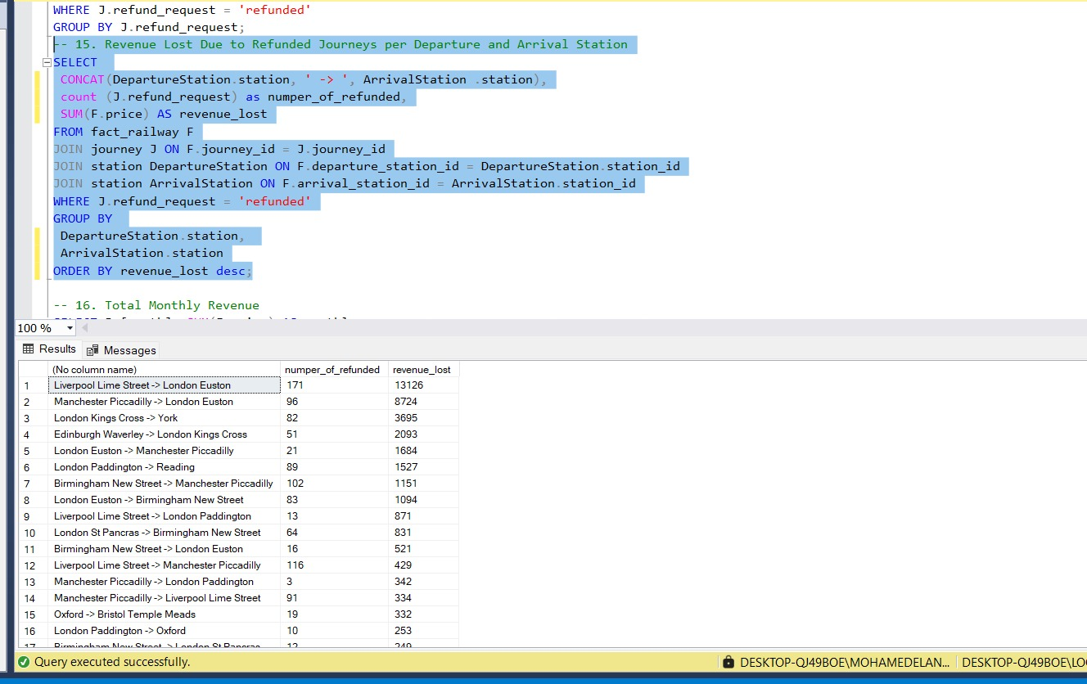

Slide 23
Forecasting Questions
O3.

Slide 24
Phase 3: Overview
focus:
Determine a set of forecasting questions
Key deliverables:
Visualization plots answering forecasting questions.
Tools:
Python

Slide 25
Visualization Dashboard
O4.

Slide 26
Phase 4: Overview
focus:
visualize all answered questions
Key deliverables:
Visualization dashboard
Final report and presentation
Tools:
PowerBI
Tableau
PowerPoint

Slide 27

PowerBI Dashboard

Slide 28
PowerBI Dashboard

Slide 29
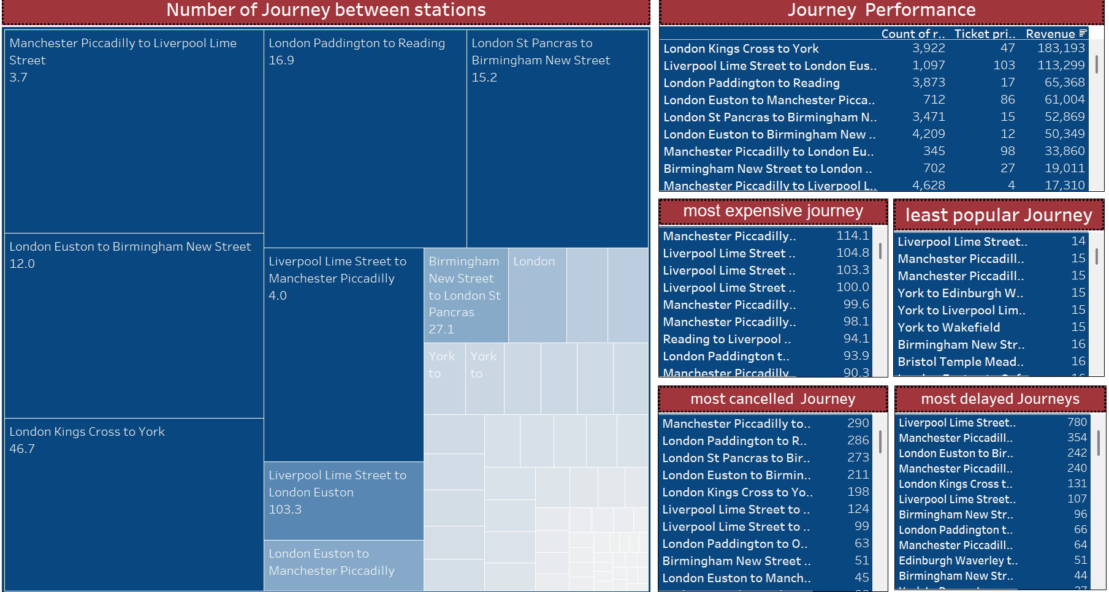
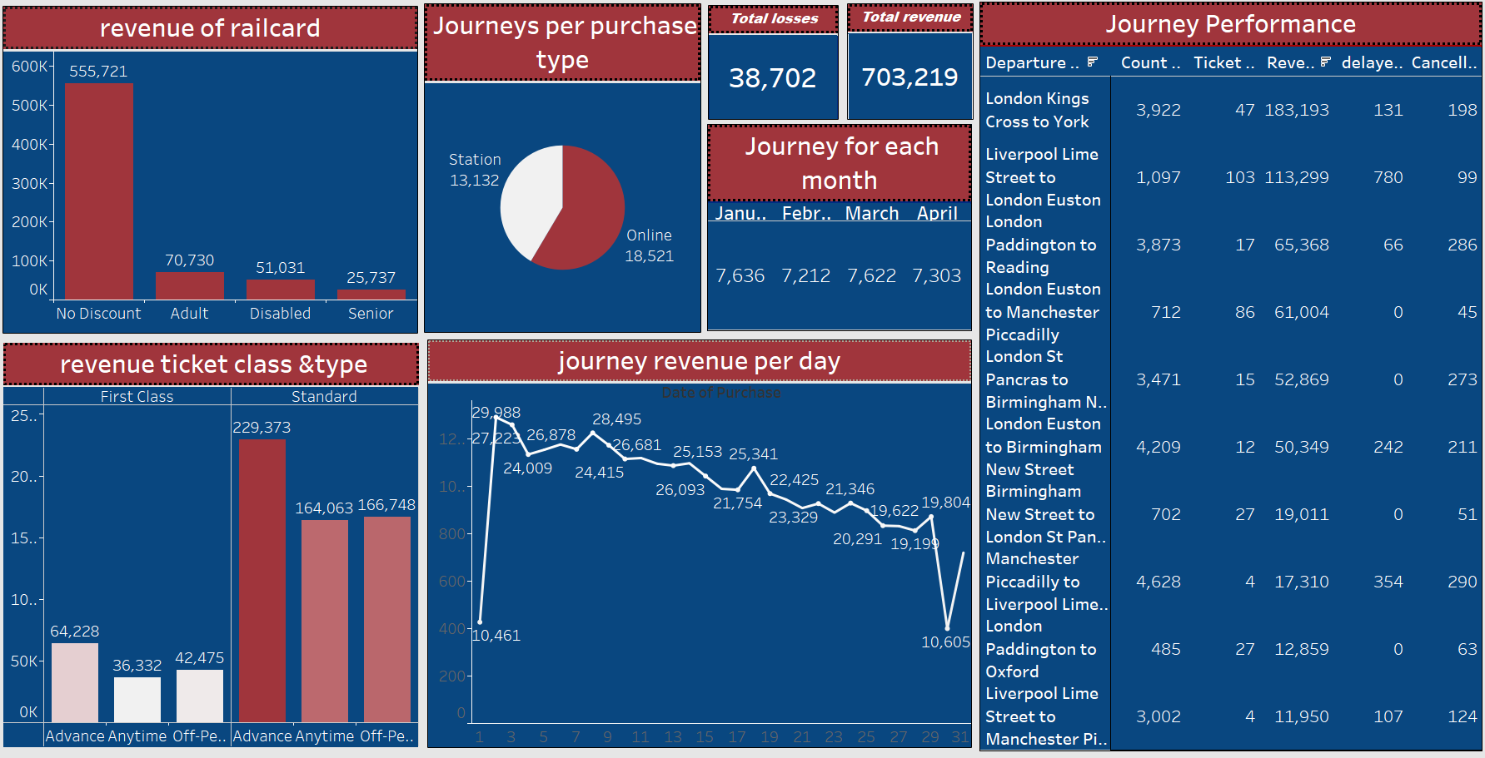
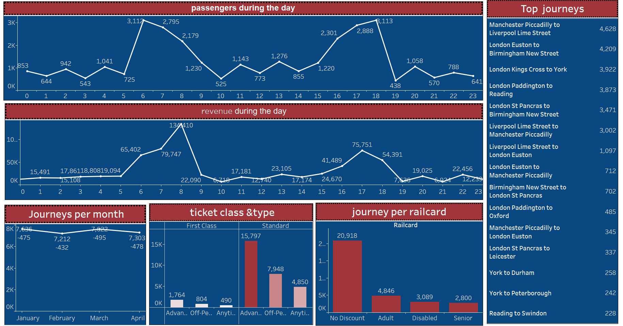

Tableau Dashboards

Slide 30
Recommendations
O5.

Slide 31
Insights
1. Journeys with the Highest Delay Rates :
Certain routes, such as Liverpool Lime Street → London Euston,
accounted for 34.06% of total delayed trips.
The most common reason for delays and cancellations was signal failure.
2. Canceled Journeys and Service Instability:
A significant number of cancellations were observed on specific routes, indicating operational or planning issues.
These routes also experienced a high volume of refund requests, highlighting poor service quality or ineffective crisis management.
3. Top Revenue-Generating Journeys: London Kings Cross → York generated revenue of £183,000. Liverpool Lime Street → London Euston recorded around £113,000 in revenue. Together, these two routes accounted for approximately 40% of total ticket sales. 4. Stations with the Highest Passenger Volumes: Manchester Piccadilly → Liverpool Lime Street London Euston → Birmingham New Street London Kings Cross → York London Paddington → Reading London St Pancras → Birmingham New Street Liverpool Lime Street → Manchester Piccadilly These six routes represent 6 out of 65 total journeys but account for approximately 75% of total passenger traffic.

Slide 32
Recommendations
Reduce Delays:
Use early weather alert systems.
Improve operations on high-delay routes.
Upgrade signal system infrastructure.
Cut Cancellations:
Optimize resource planning on unstable routes.
Train staff on emergencies & passengers handling .
Boost Revenue:
Enhance premium route experience.
Launch loyalty deals and flexible pricing.
Manage Crowds:
Expand peak-hour service & station capacity.
Improve signs and guidance to reduce crowding and confusion.
Lower Refunds:
Provide real-time alternatives during cancellations.
Increase service reliability.

Slide 33

THANKS!
DO YOU HAVE ANY QUESTIONS?

